Slide 1
Few-Shot Learning Unsupervised Domain Adaptation

Slide 2
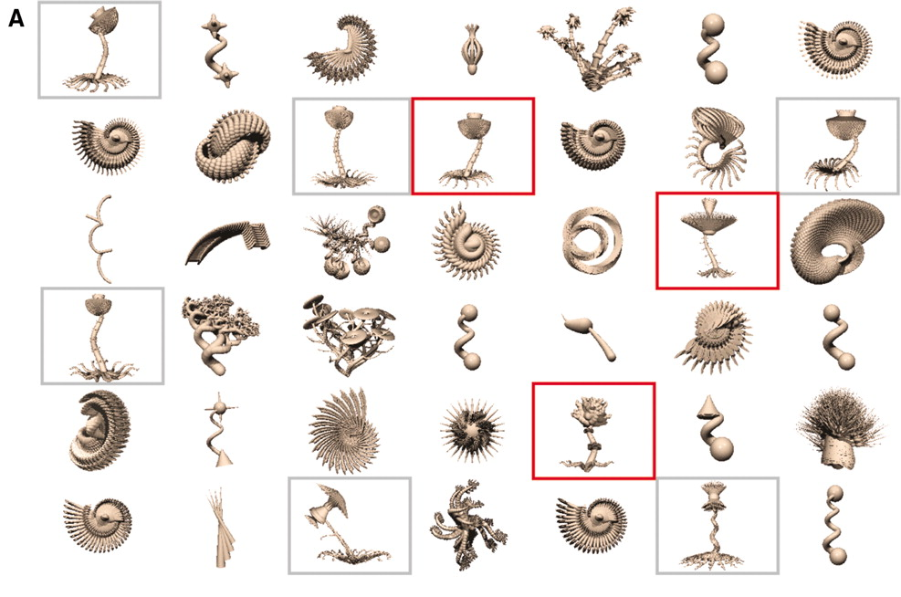
Tenenbaum, Joshua B., et al. "How to grow a mind: Statistics, structure, and abstraction." science 331.6022 (2011): 1279-1285.

Slide 3
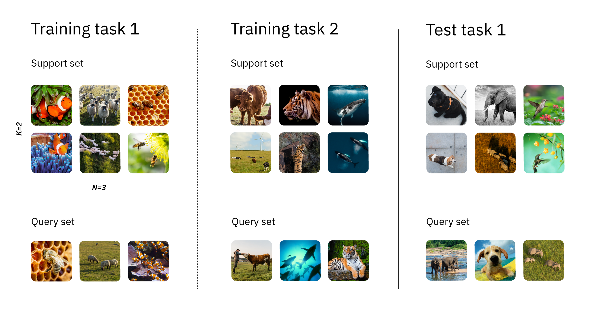
Few-Shot Learning
N-way-K-shot classification
3-way-2-shot

Slide 4
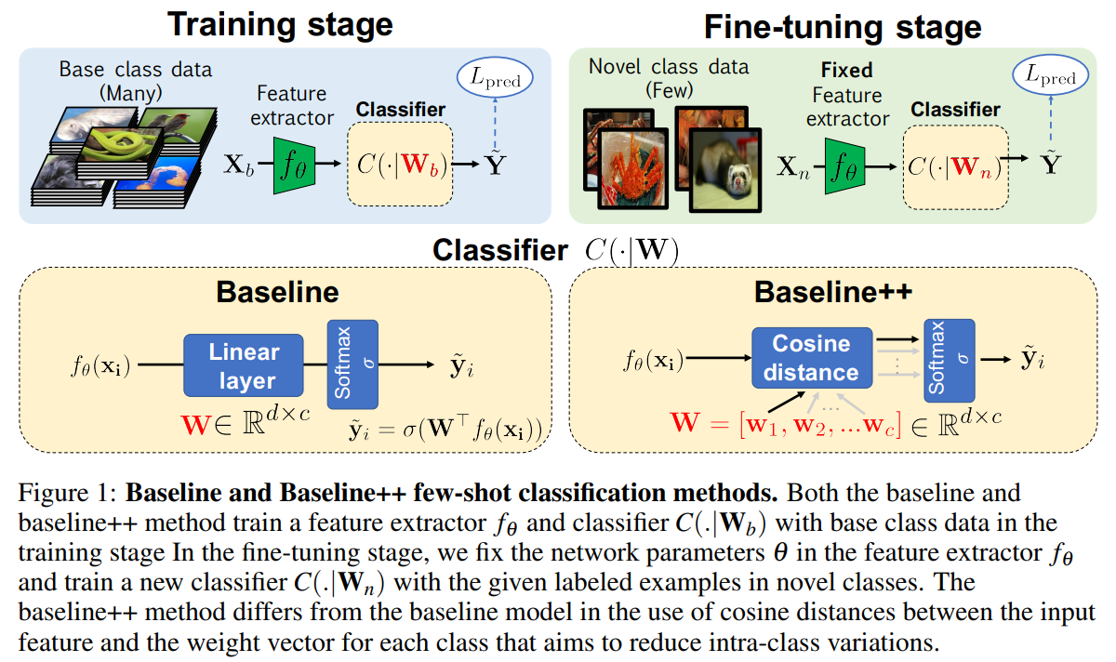

Slide 5
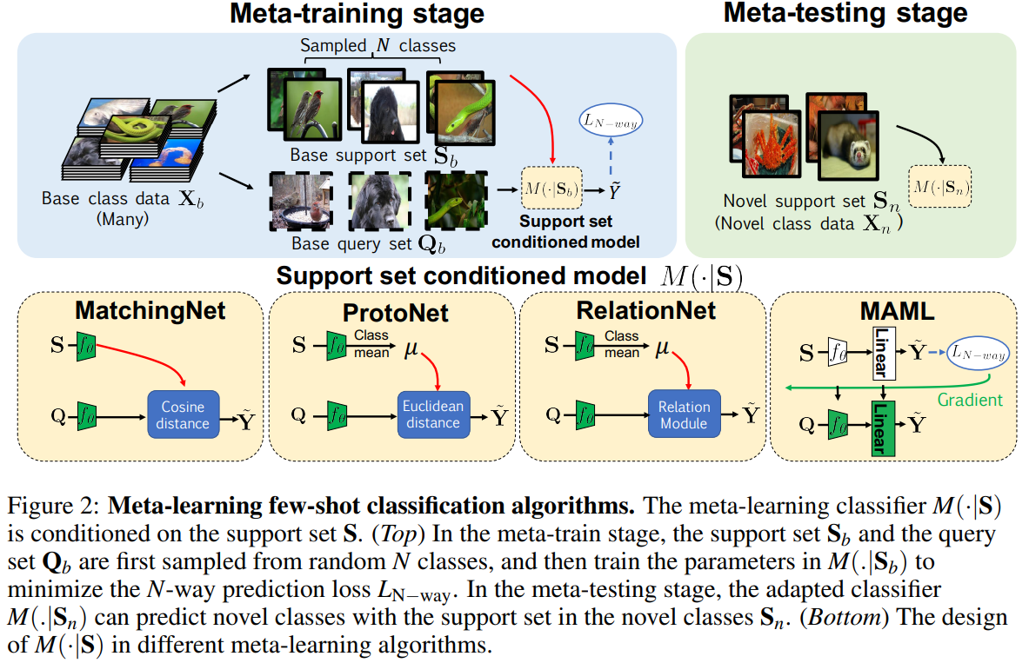

Slide 6
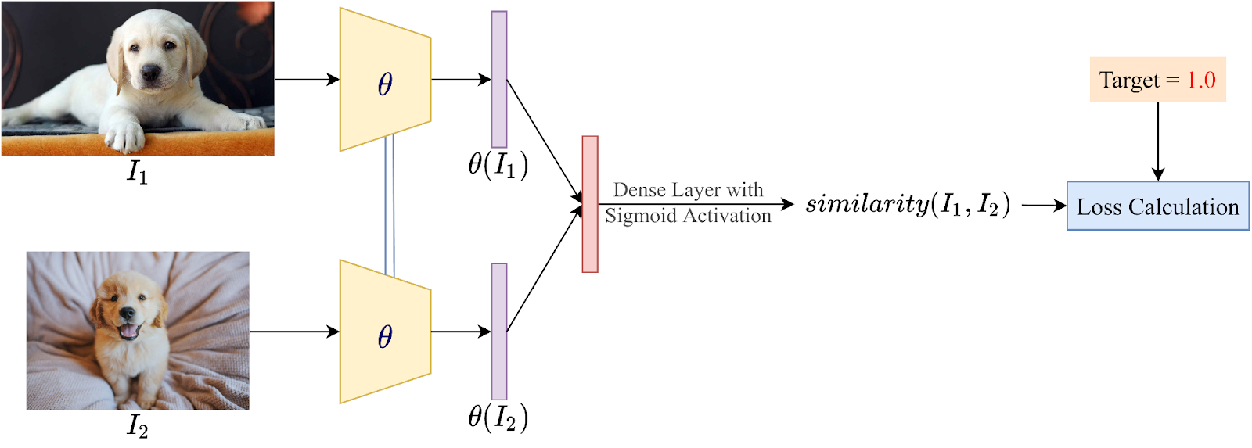
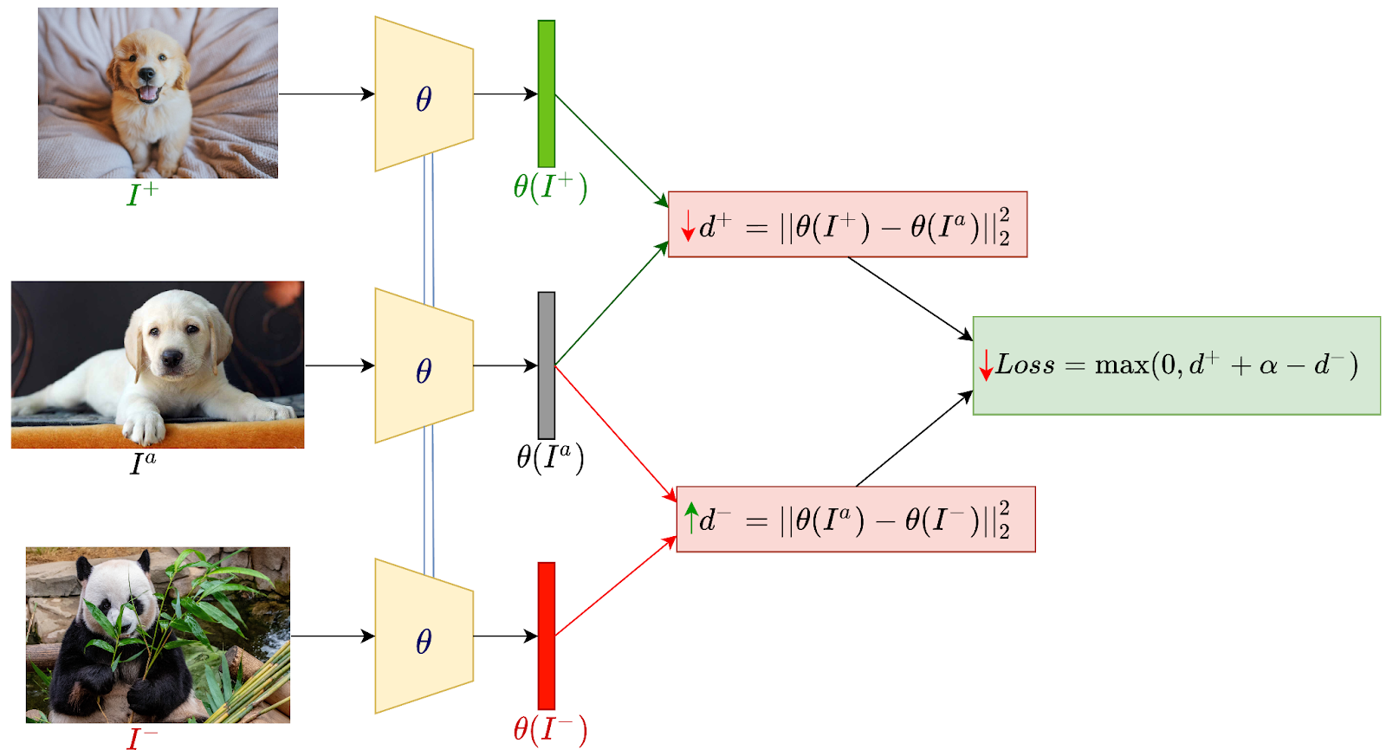
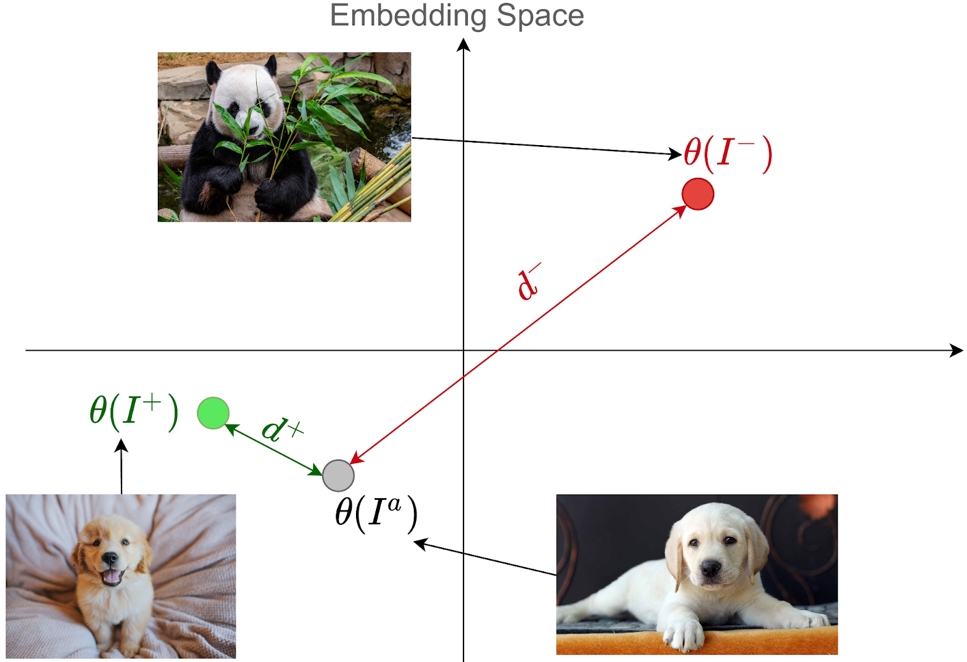
1 Metric Learning (learning to compare)
Siamese Neural Networks

Slide 7
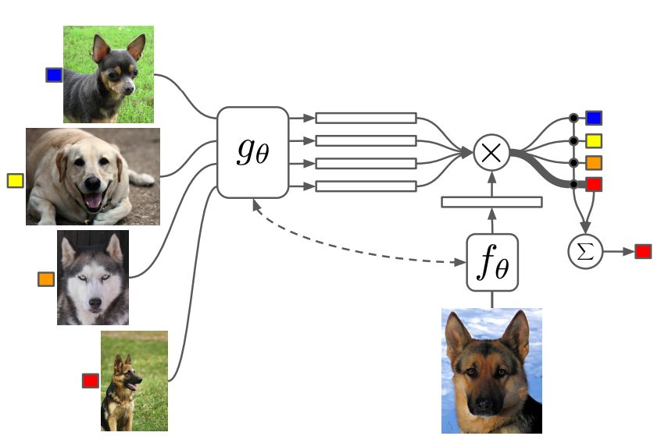
1 Metric Learning (learning to compare)
Matching Networks

Slide 8
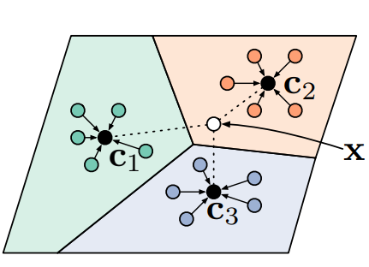
1 Metric Learning (learning to compare)
Prototypical Networks

Slide 9
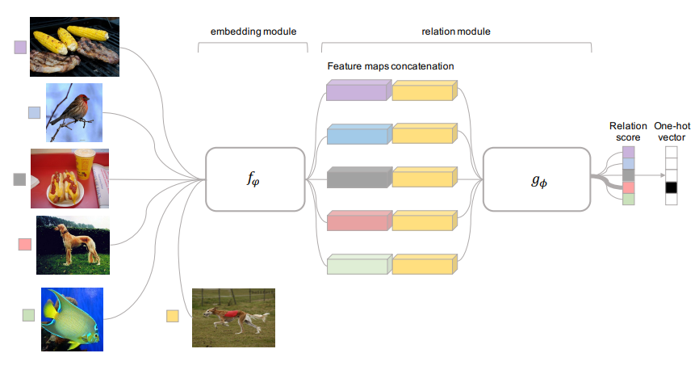
1 Metric Learning (learning to compare)
Relation Networks

Slide 10
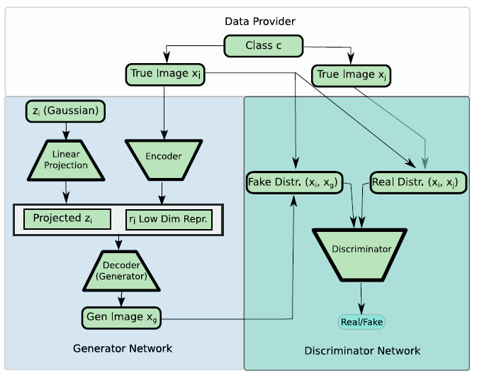
2 Data augmentation methods (learning to augment)

Slide 11
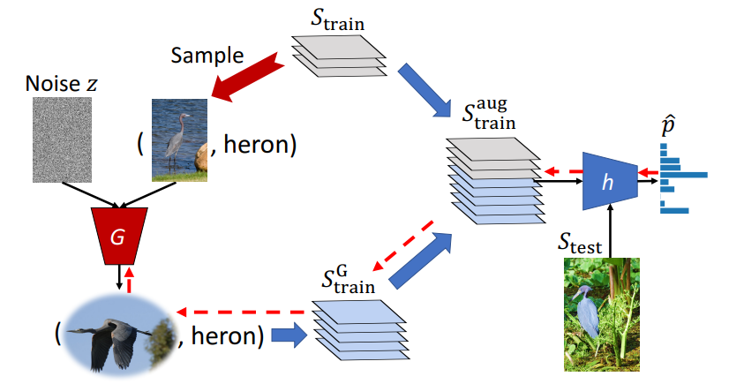
2 Data augmentation methods (learning to augment)

Slide 12
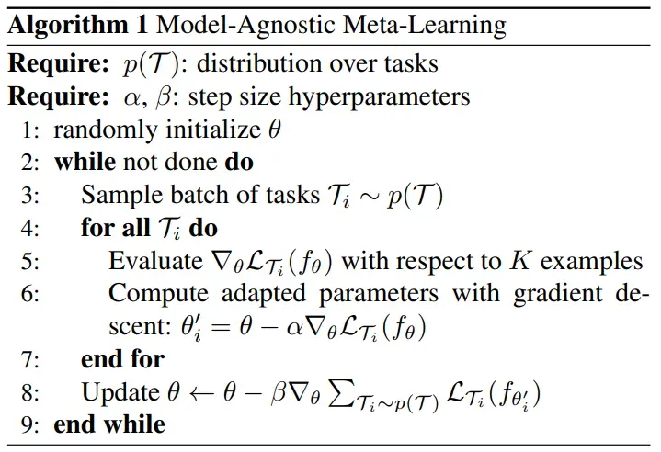
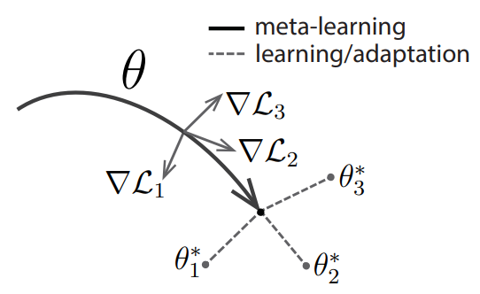
3 Meta-learning (learning to learn)
Model Agnostic Meta-Learning (MAML)

Slide 13
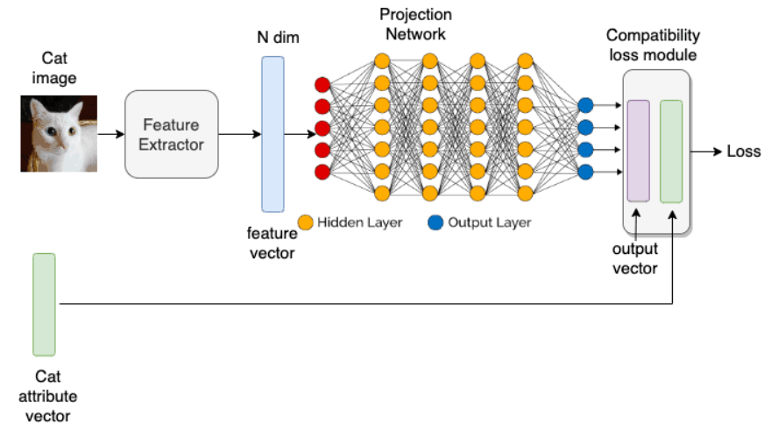
Zero-Shot Learning
Embedding-Based Approach
Contrastive Language-Image Pre-Training (CLIP) is a popular ZSL model that uses a variant of the embedding-based approach by converting images and corresponding labels into embeddings through image and text encoders.

Slide 14
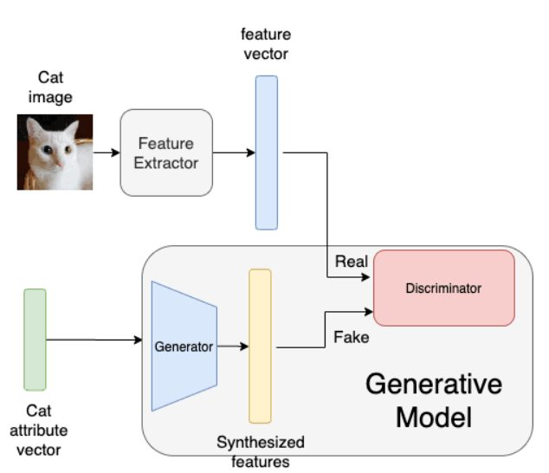
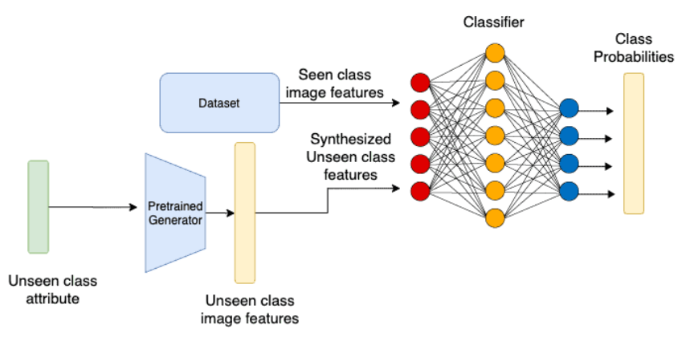
Zero-Shot Learning
Generative-Based Approach
GANs: Training the Generator
GANs: Using the Generator to create synthetic feature vectors

Slide 15
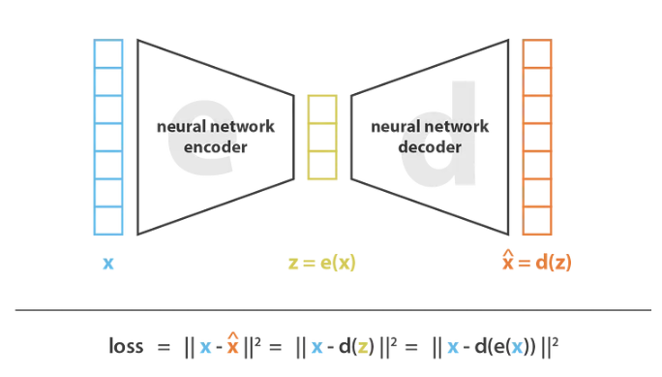
Zero-Shot Learning
Generative-Based Approach

Slide 16
N-Shot Learning Applications
Medical Image Analysis
Visual-Question Answering (VQA)
Autonomous Driving
Image Retrieval and Action Recognition
Text Classification
Face Recognition

Slide 17
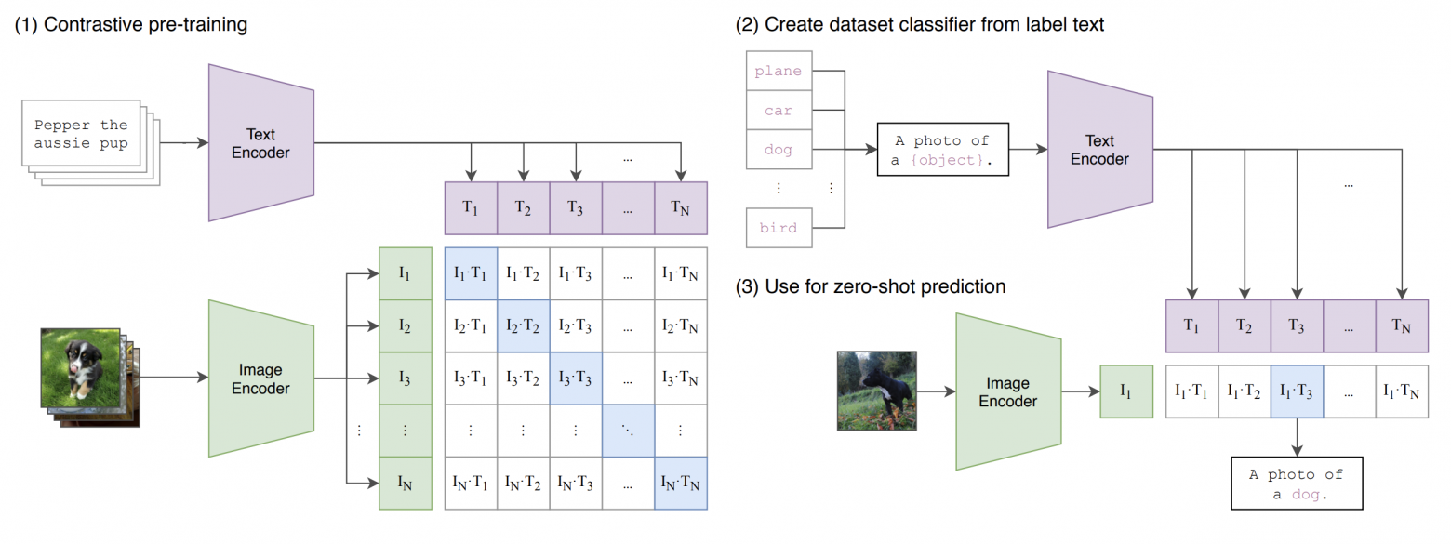
CLIP

Slide 18
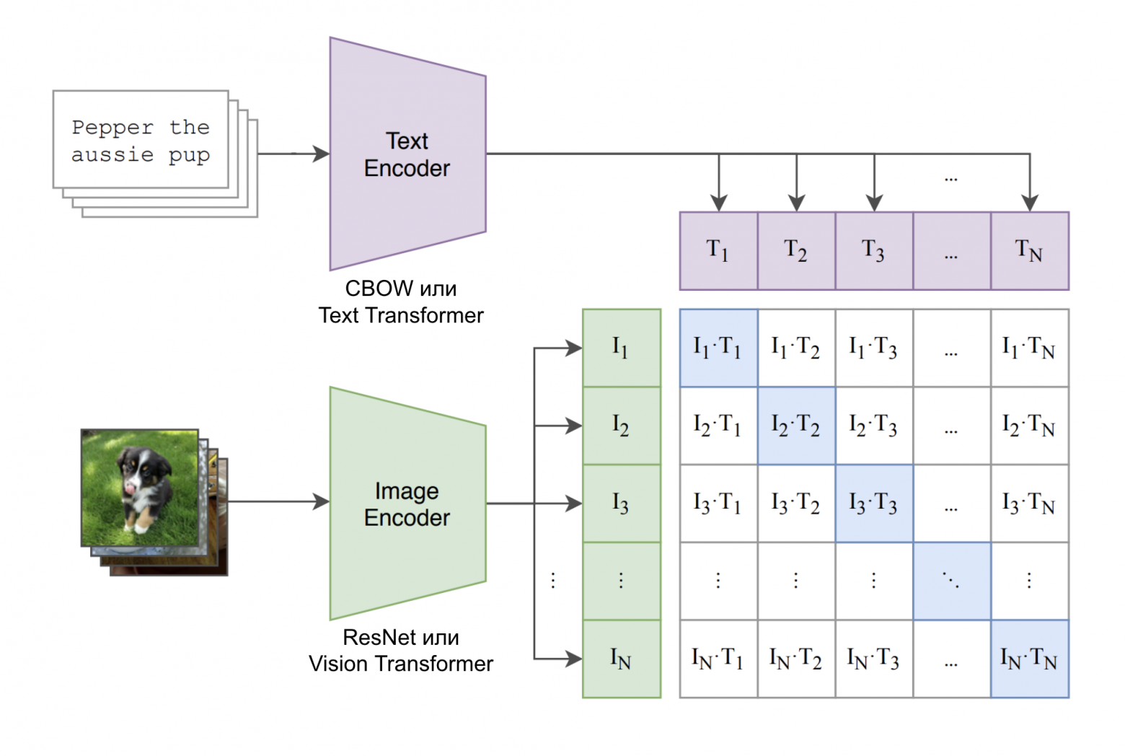
CLIP

Slide 19
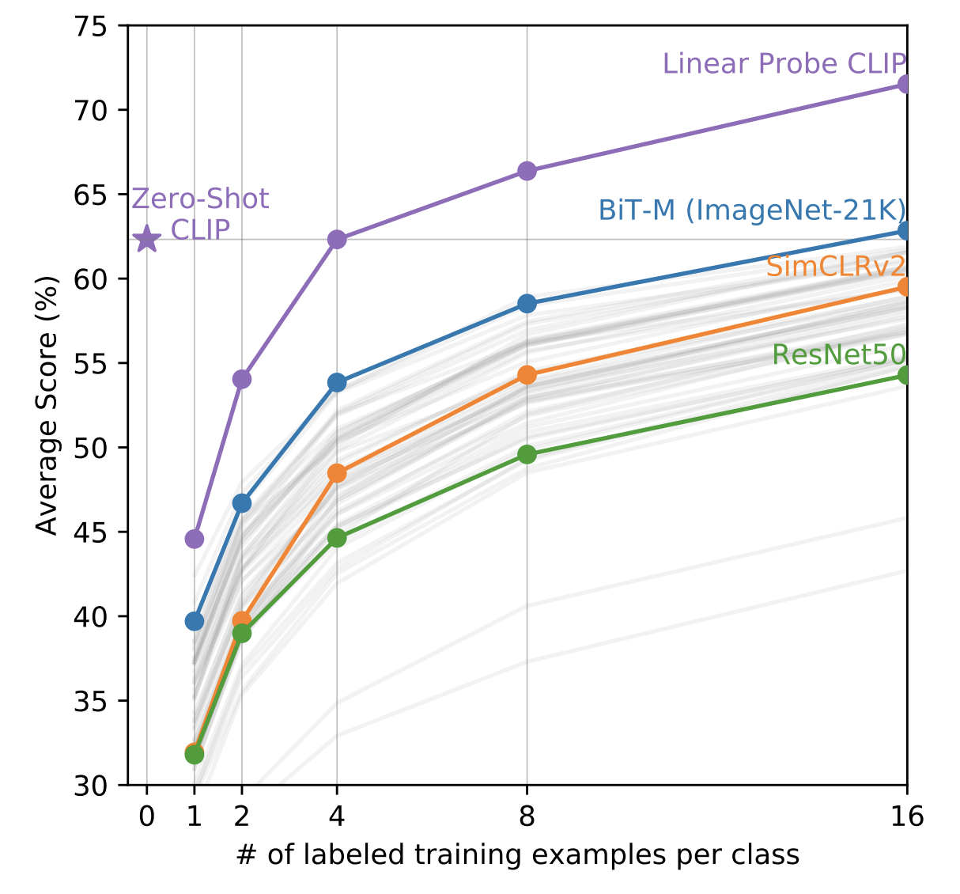
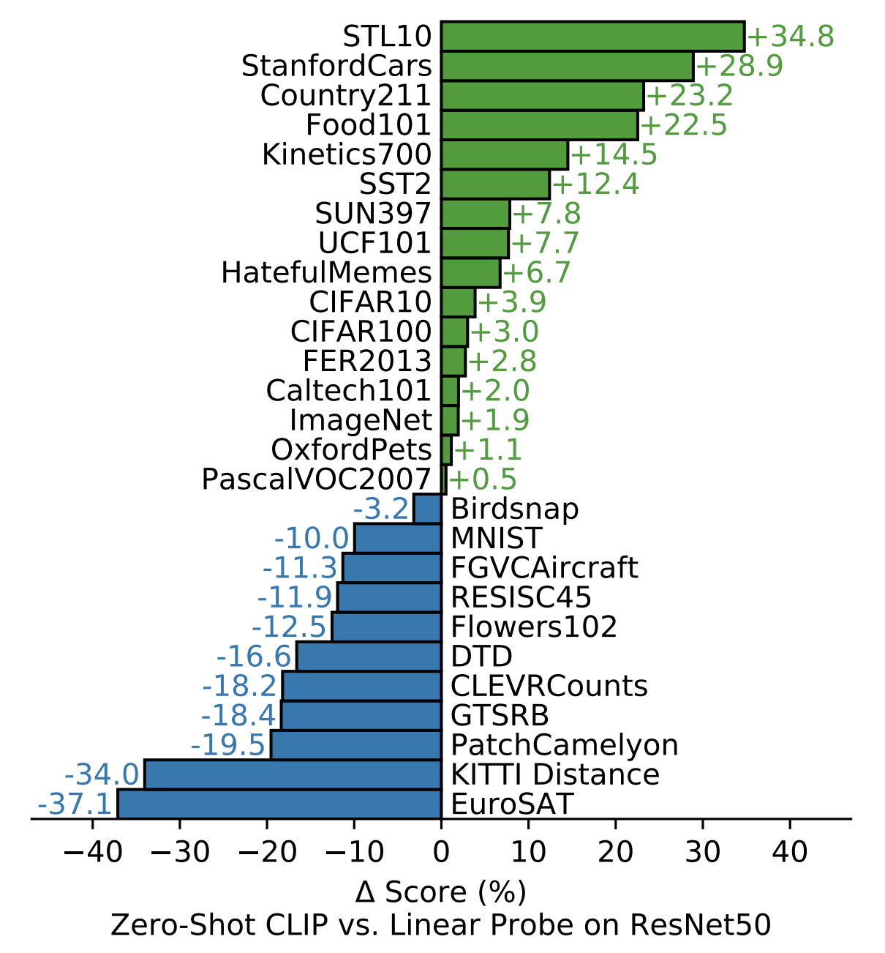
CLIP

Slide 20
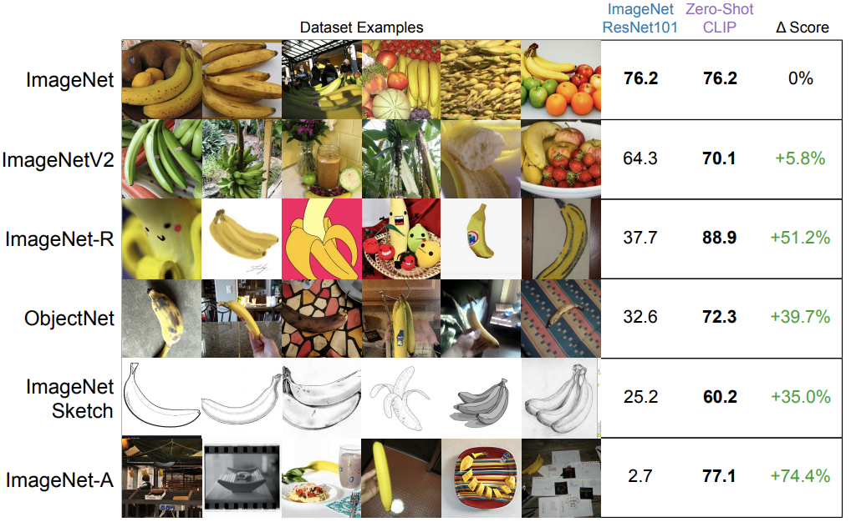
CLIP

Slide 21
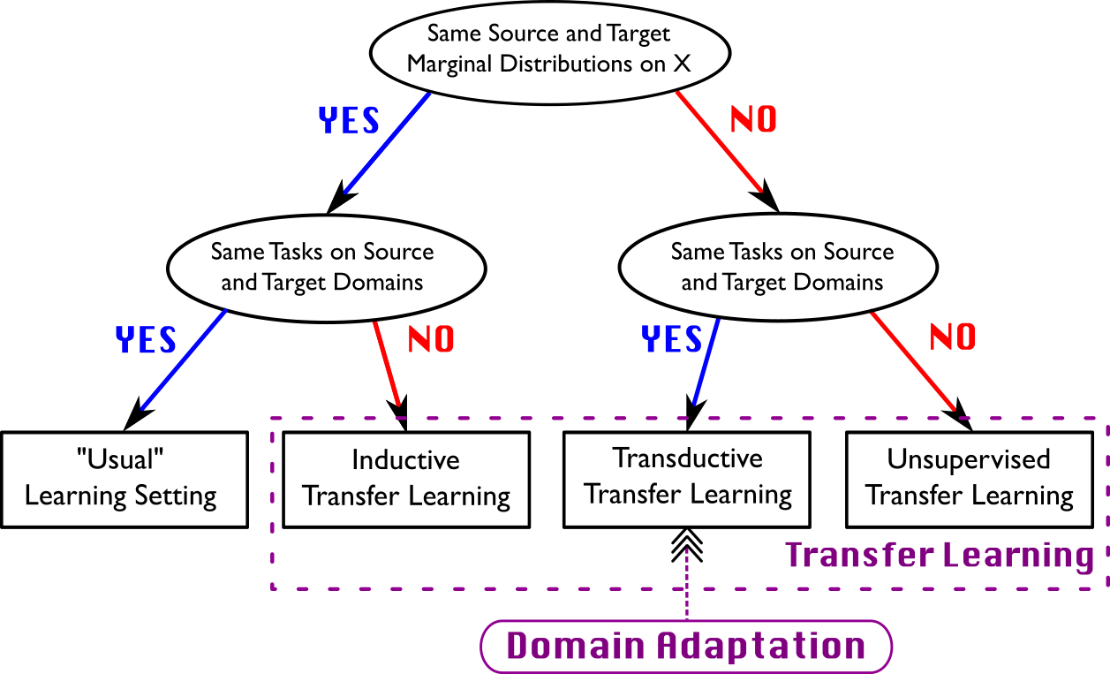
Domain Adaptation

Slide 22
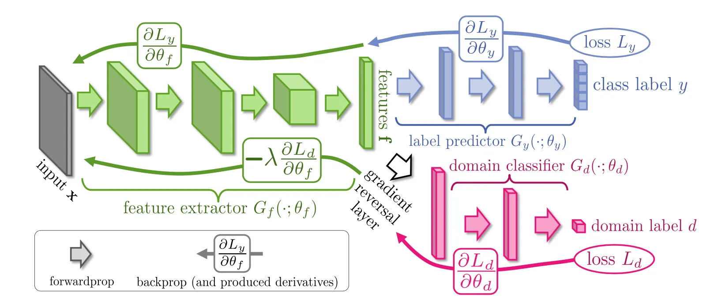
Unsupervised Domain Adaptation
Ganin, Y., & Lempitsky, V. (2014)
https://arxiv.org/pdf/1409.7495
Unsupervised Domain Adaptation by Backpropagation
https://jmlr.org/papers/volume17/15-239/15-239.pdf

Slide 23
Полезные материалы
Few-Shot Learning
https://www.youtube.com/watch?v=Xuat7kHYwno&list=PL1pUDpkFOnlzeLCZ5aZgSXVZ8BcpCYN8Y
https://www.youtube.com/watch?v=ppC9ruaVuQQ
https://www.ibm.com/topics/few-shot-learning
https://github.com/sicara/easy-few-shot-learning
CLIP
https://github.com/openai/CLIP
https://habr.com/ru/articles/539312/
Unsupervised Domain Adaptation
https://github.com/adapt-python/adapt
https://arxiv.org/abs/2409.15264v1
https://github.com/ViLab-UCSD/UDABench_ECCV2024
https://www.youtube.com/watch?v=5SsEZvlYqqM&list=PLOQ9wdSxLW097UBdObI2vdereGJgA74Nb&index=25

